Slide 1


The Effect of Fare Evasion Crime on MTA IN NY
EXPLORATORY DATA ANALYSIS
Ahad Saad Almutairi

Slide 2
01. FARE EVASION CRIME
04. DATA CLEANING
02. ARISING ISSUES
05. EDA GRAPHS + INSIGHTS
03. DATASETS + TOOLS
06. CONCLUSION + RECCOMENDATION

Slide 3
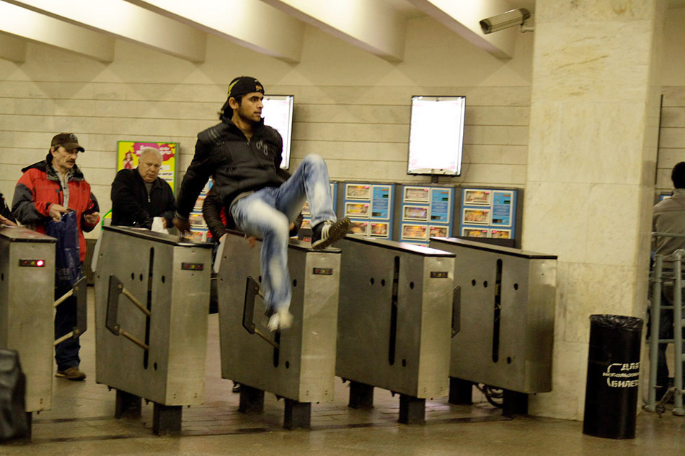
FARE EVASION
is the act of travelling on public transport without paying

Slide 4

WHATS THE ISSUE?
FINANCIAL LOSS
HIGH FARE EVASION CRIME RATE

Slide 5
DATASET
MTA TURN STILE DATASET
ARRESTS FOR FARE EVASION DATASET
SAMPLE:2018
SAMPLE:2018

Slide 6

TOOLS
NUMPY
JUPYTER NOTEBOOK
PANDAS
PYTHON
MATPLOTLIB
SQLALCHEMY
SEABORN

Slide 7
DATA CLEANING
01
02
03
Stripping whitespaces from columns
Duplicated values
Getting rid of irregular readings
04
05
06
Focusing on entries only
Eliminating outliers
Eliminating false readings
(negative values, huge values)

Slide 8
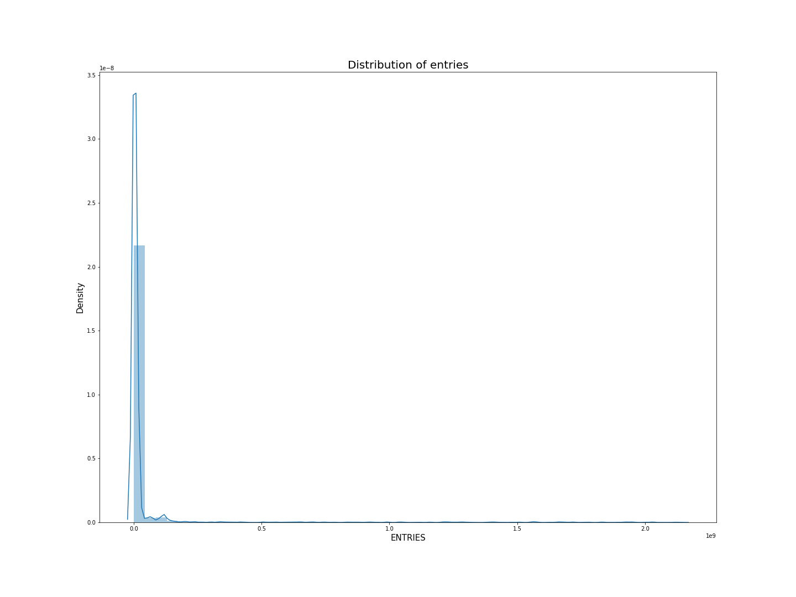
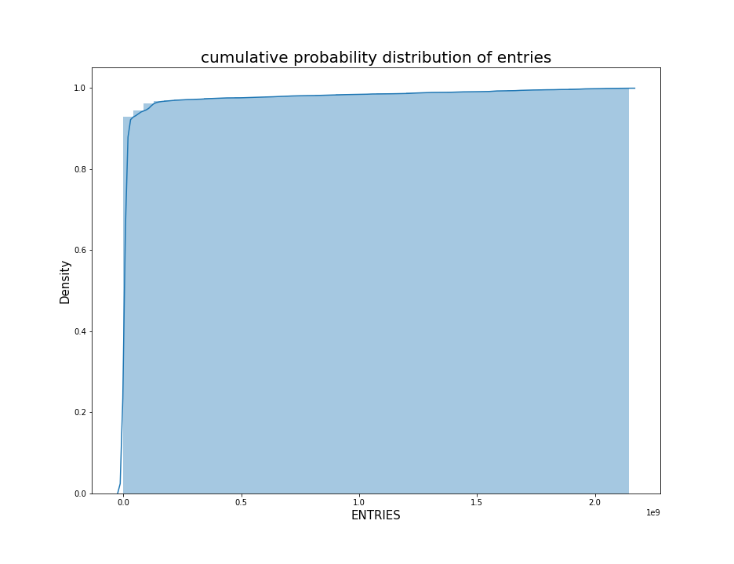
Data Cleaning

Slide 9
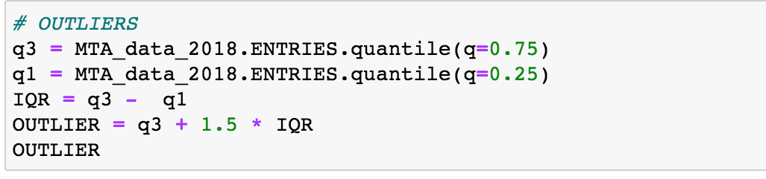
Data Cleaning

Slide 10
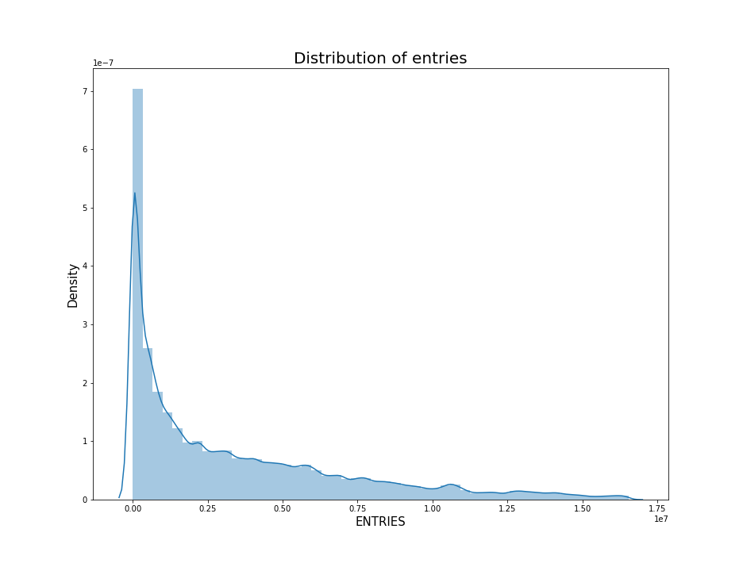
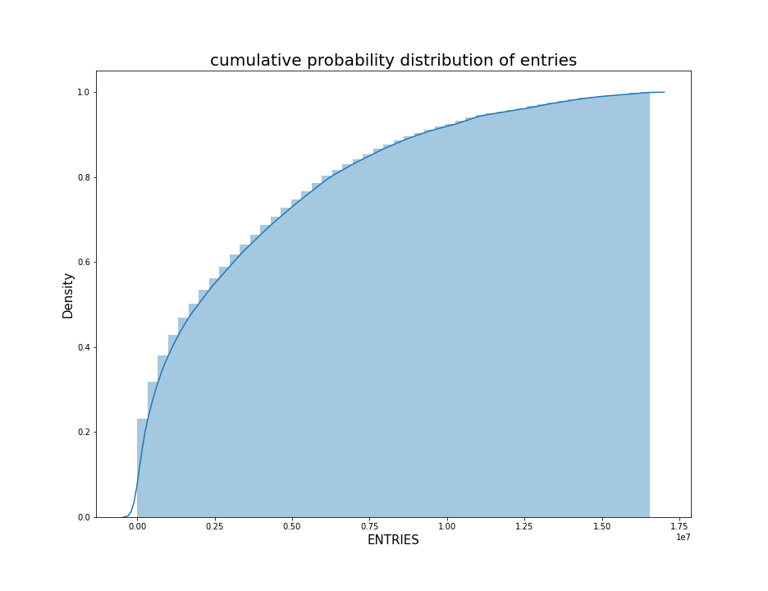
Data Cleaning

Slide 11
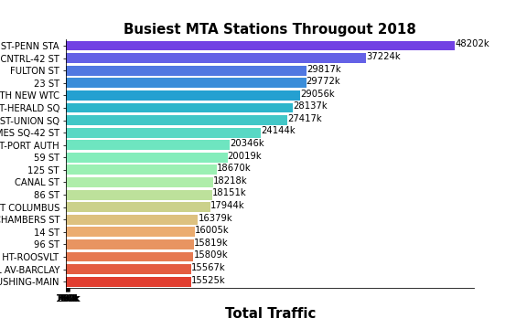
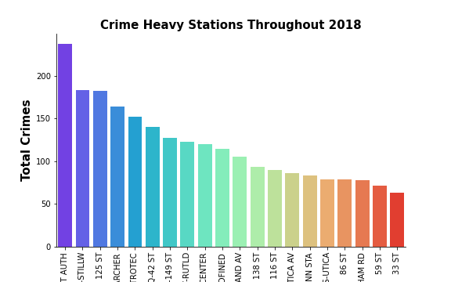
ANALYSIS

Slide 12
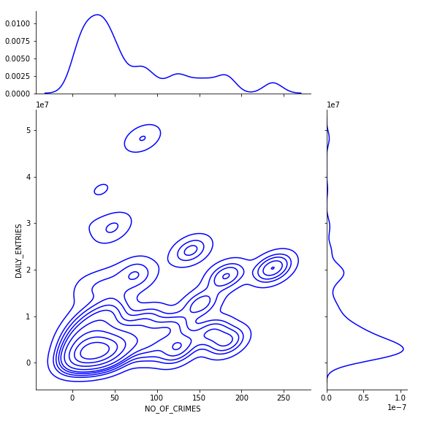
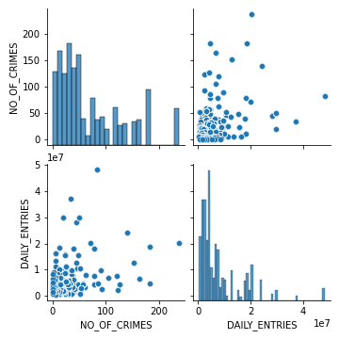
CORRELATION

Slide 13
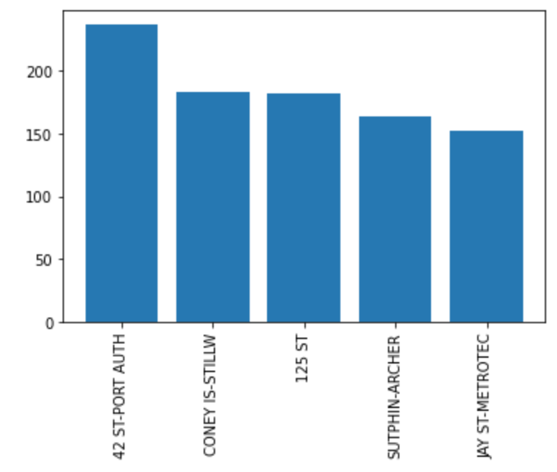
ANALYSIS OF THE TOP HEAVY CRIME STATIONS

Slide 14
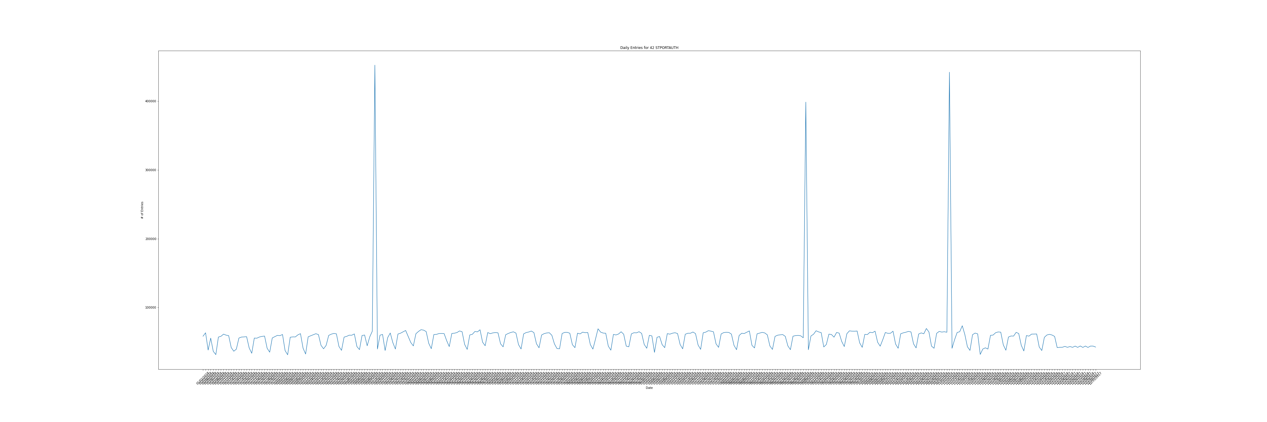
ANALYSIS OF THE TOP HEAVY CRIME STATIONS

Slide 15
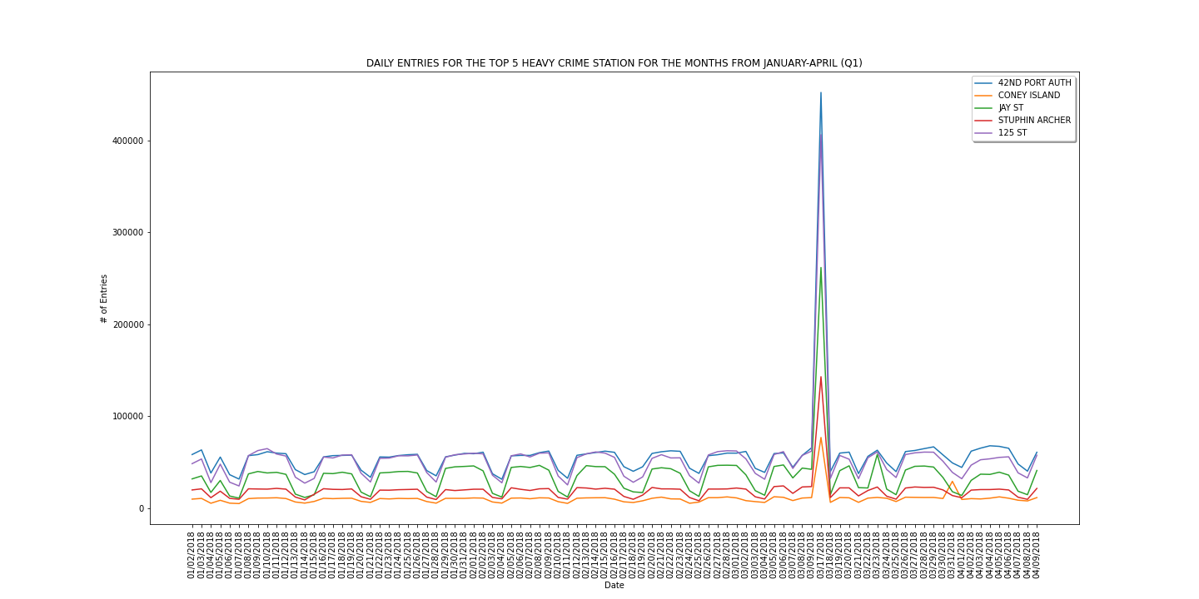
ANALYSIS OF THE TOP HEAVY CRIME STATIONS

Slide 16
ANALYSIS OF THE TOP HEAVY CRIME STATIONS

Slide 17
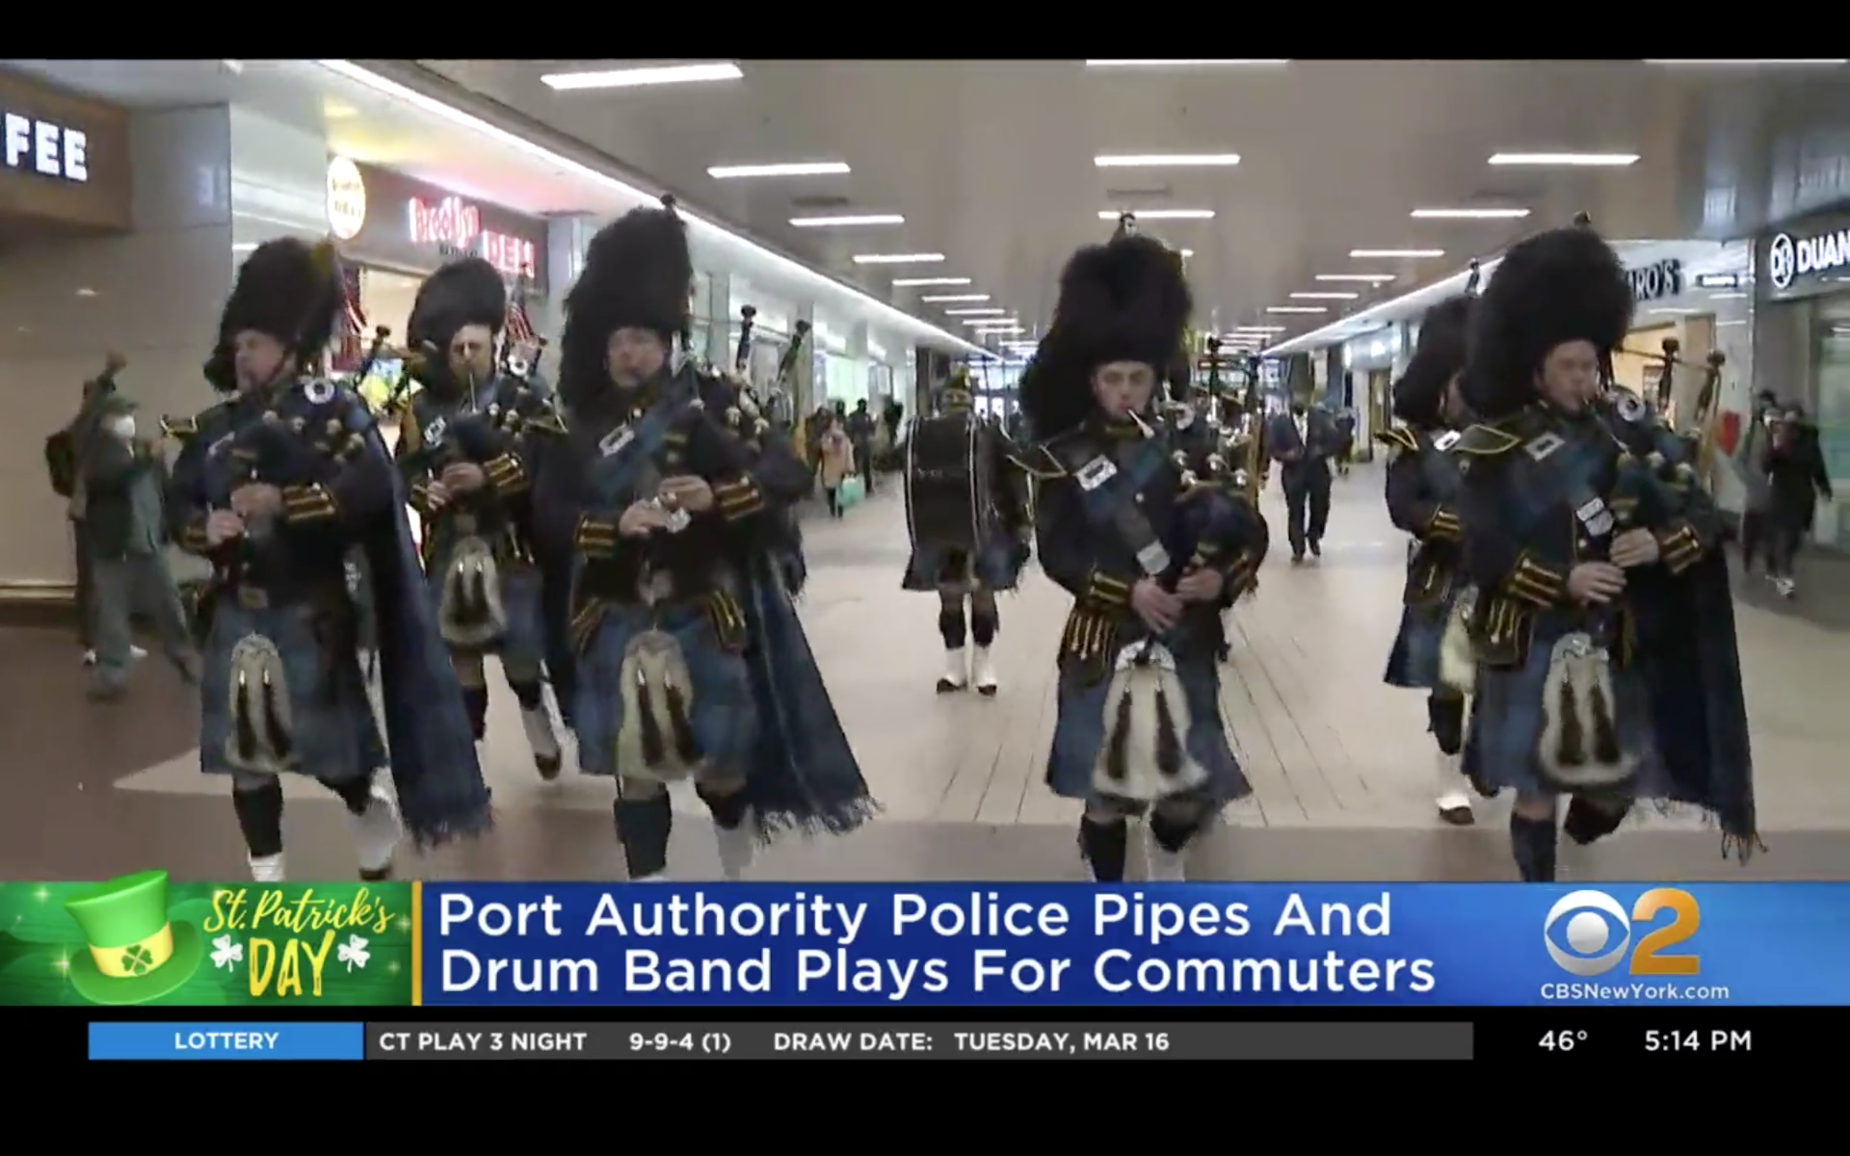
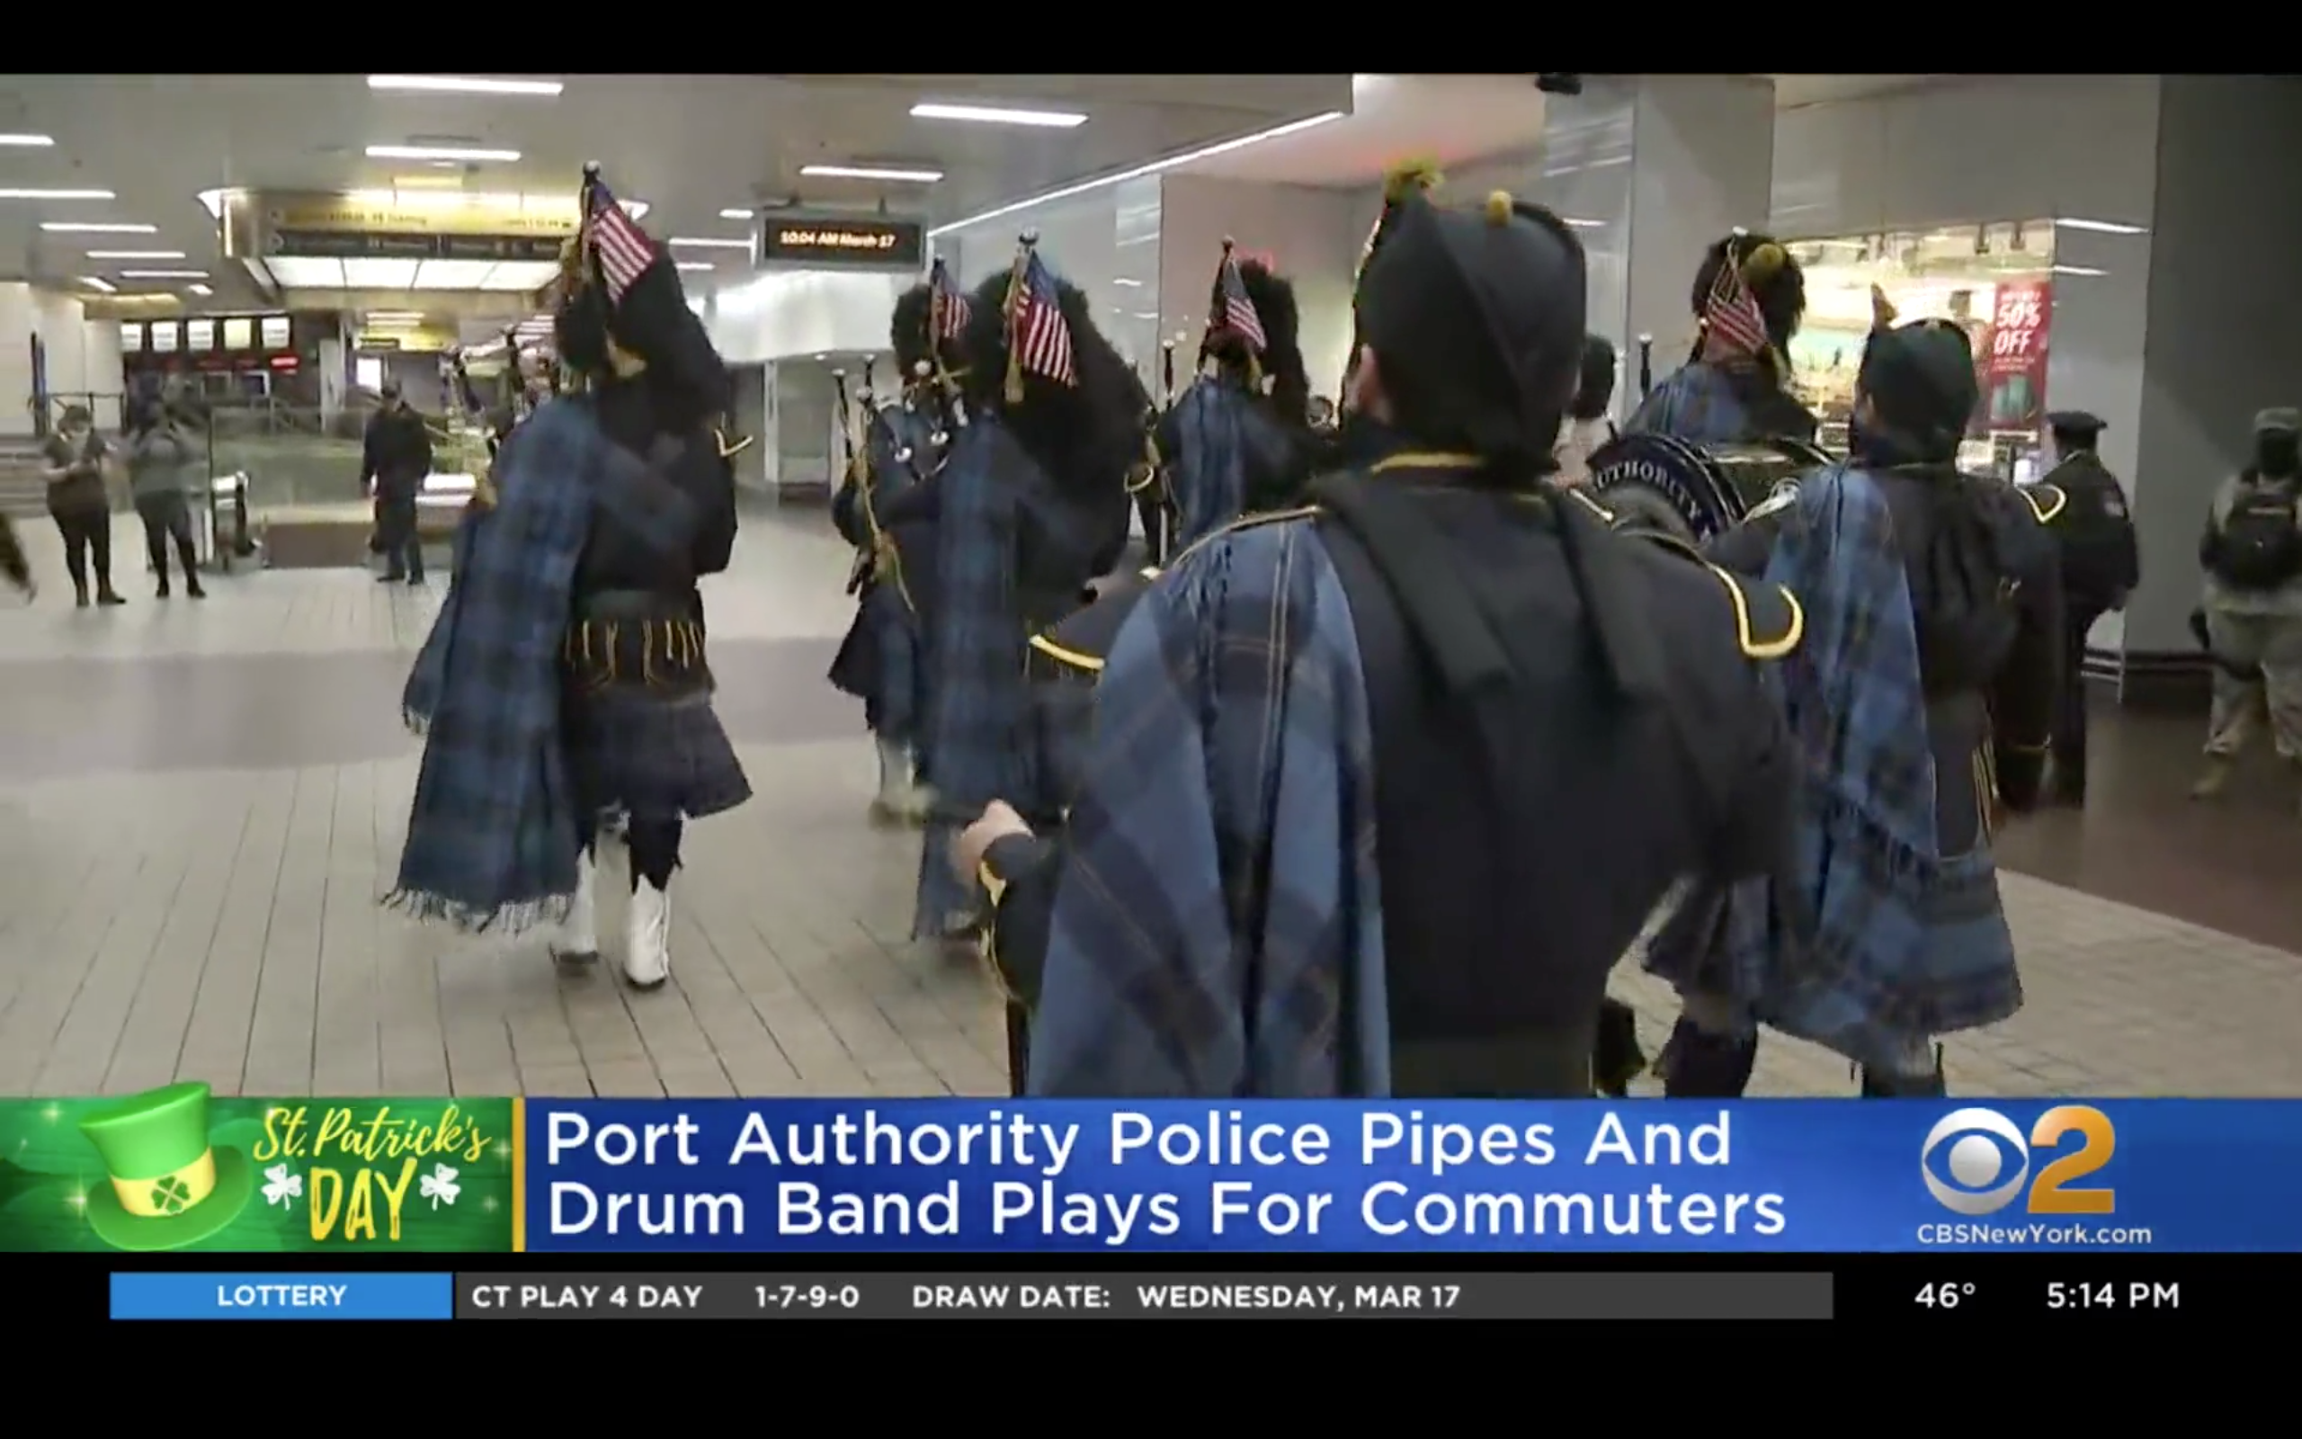
ANALYSIS OF THE TOP HEAVY CRIME STATIONS

Slide 18
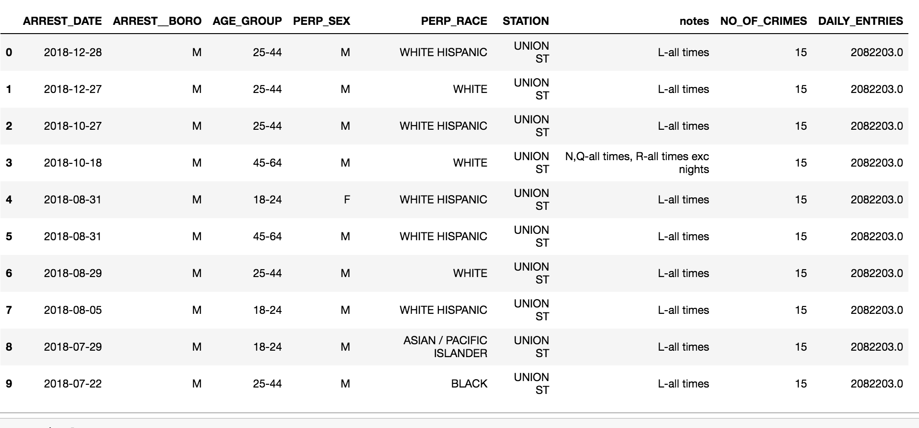
MERGING TWO DATASETS

Slide 19
OBSTECLES
DIFFERENT VALUES WHILE MERGING WILL RESULT IN EMPTY DATAFRAME
MORE VALUES FOR MEANINGFUL CORRELATION

Slide 20
INSIGHTS

Slide 21
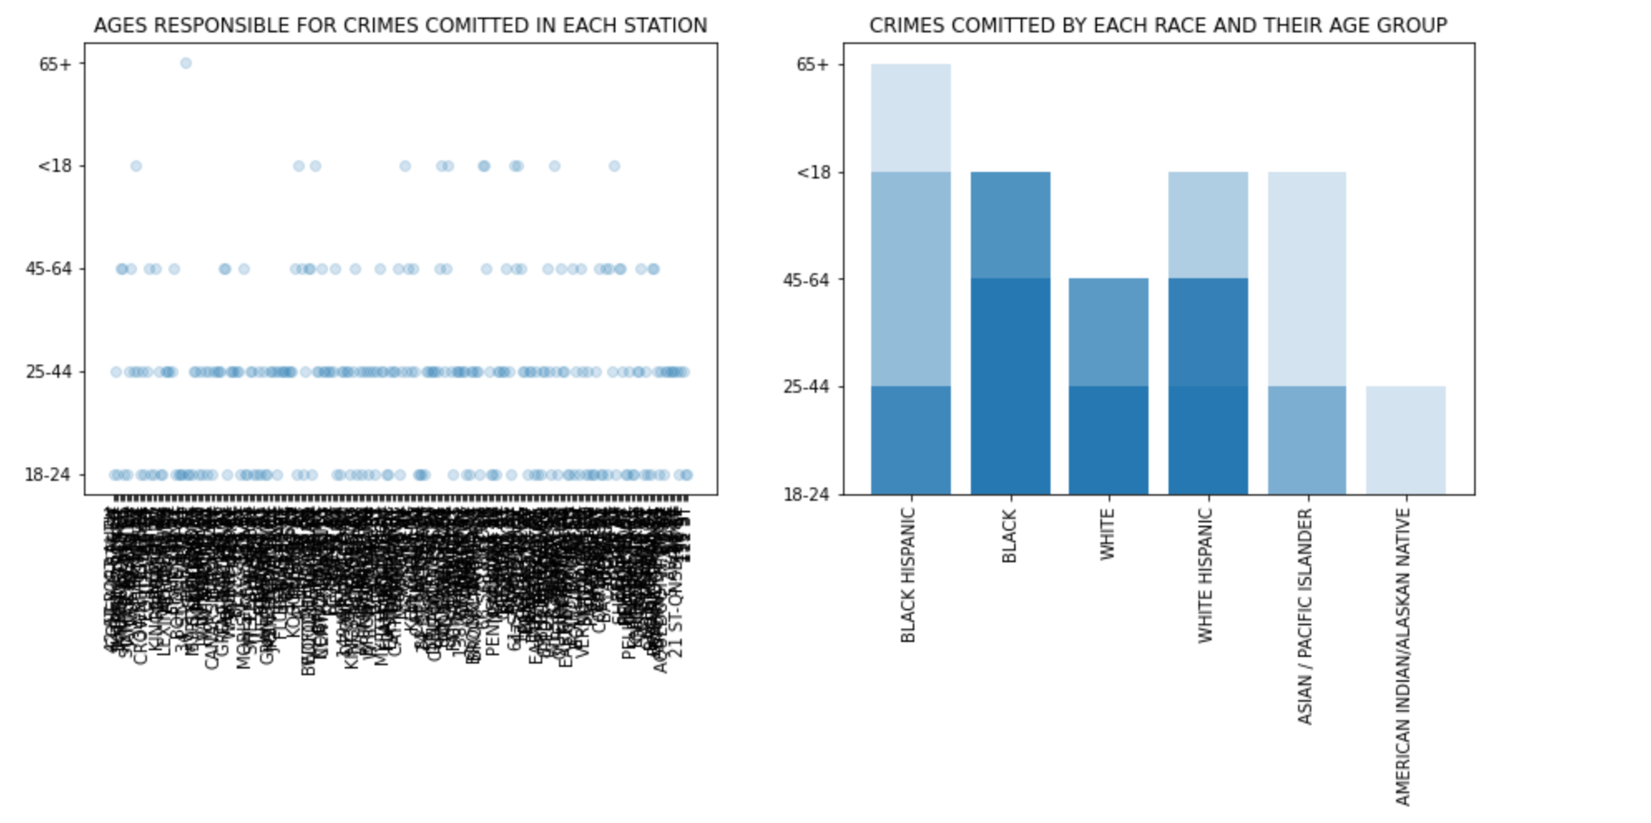
ALL STATIONS

Slide 22
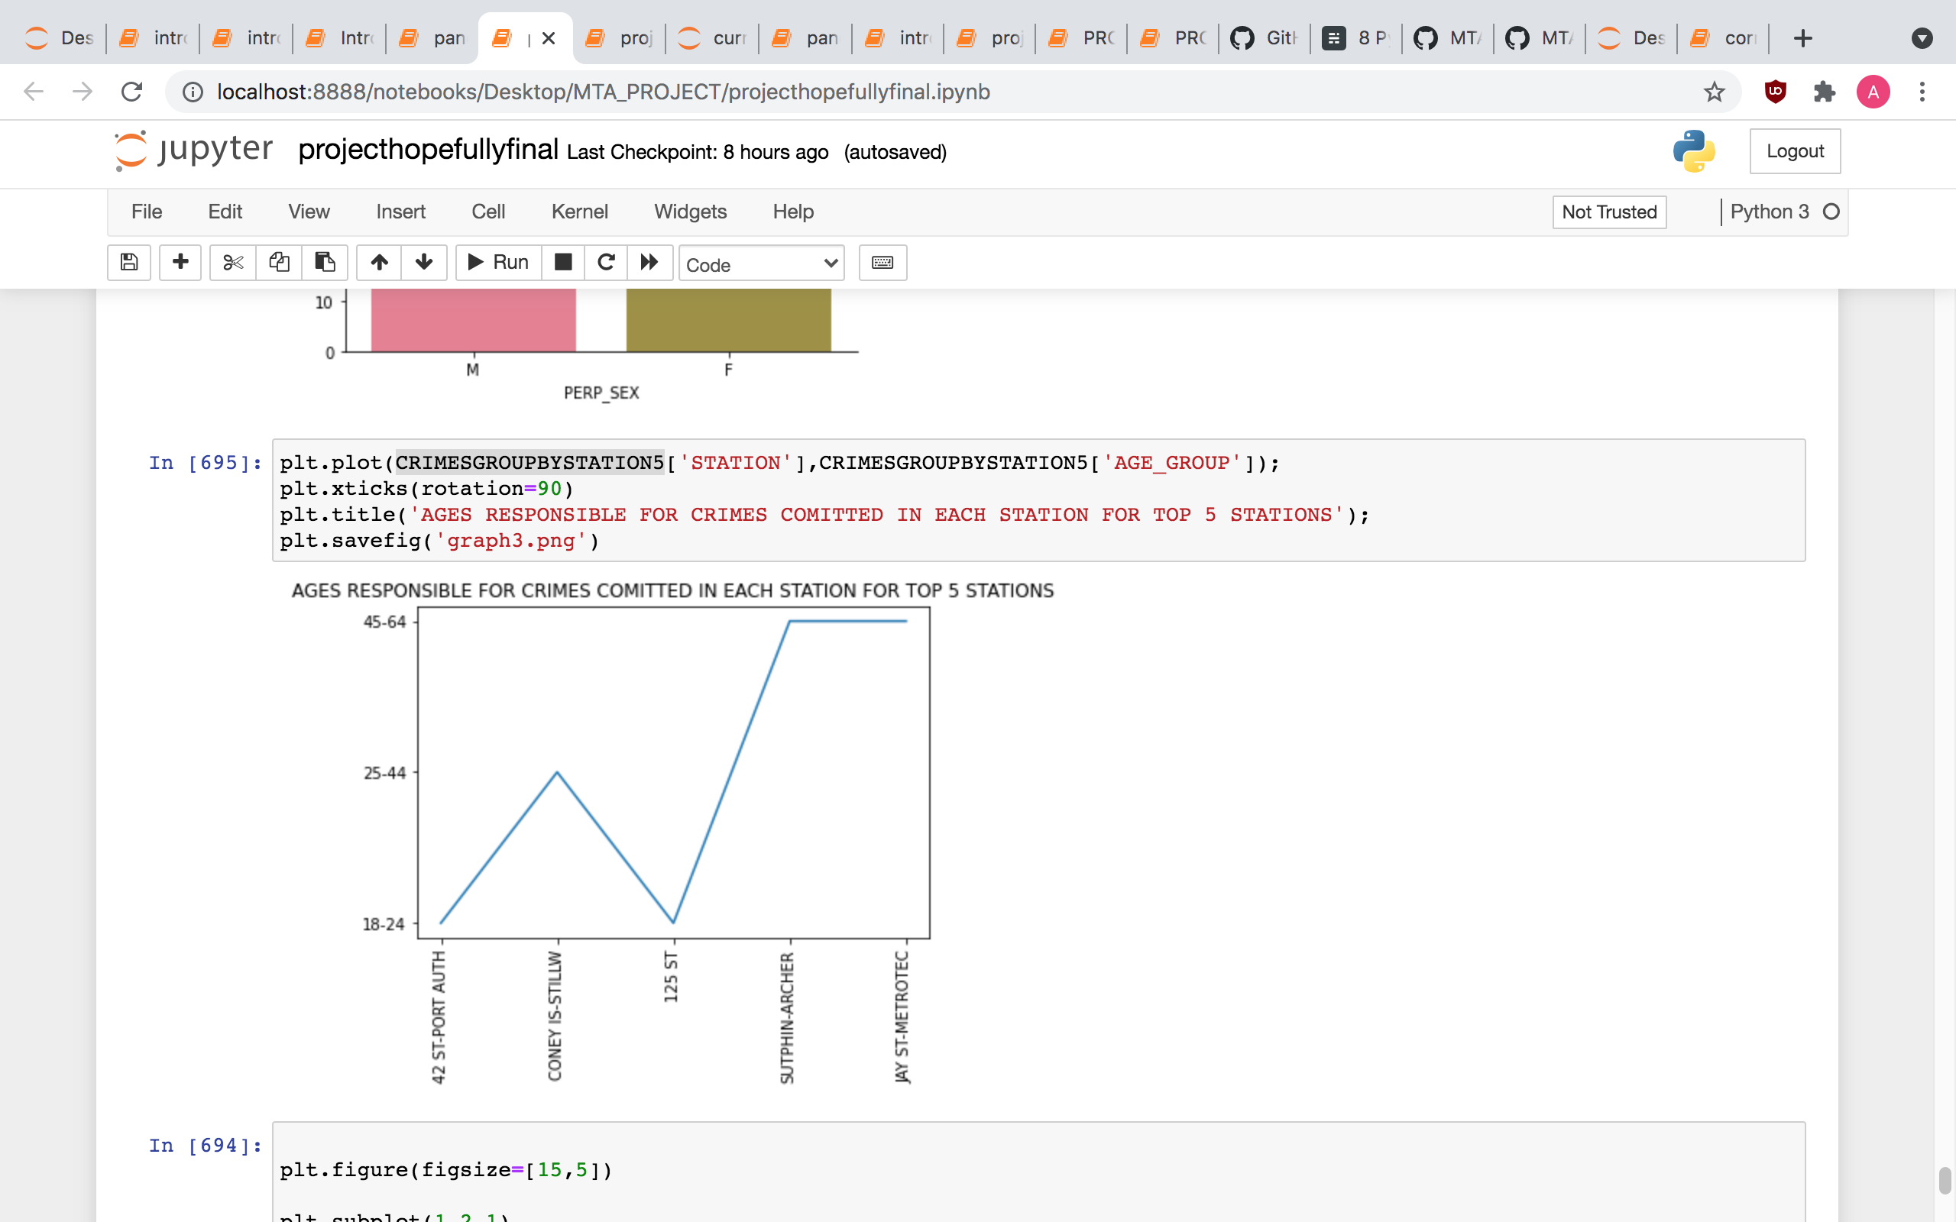
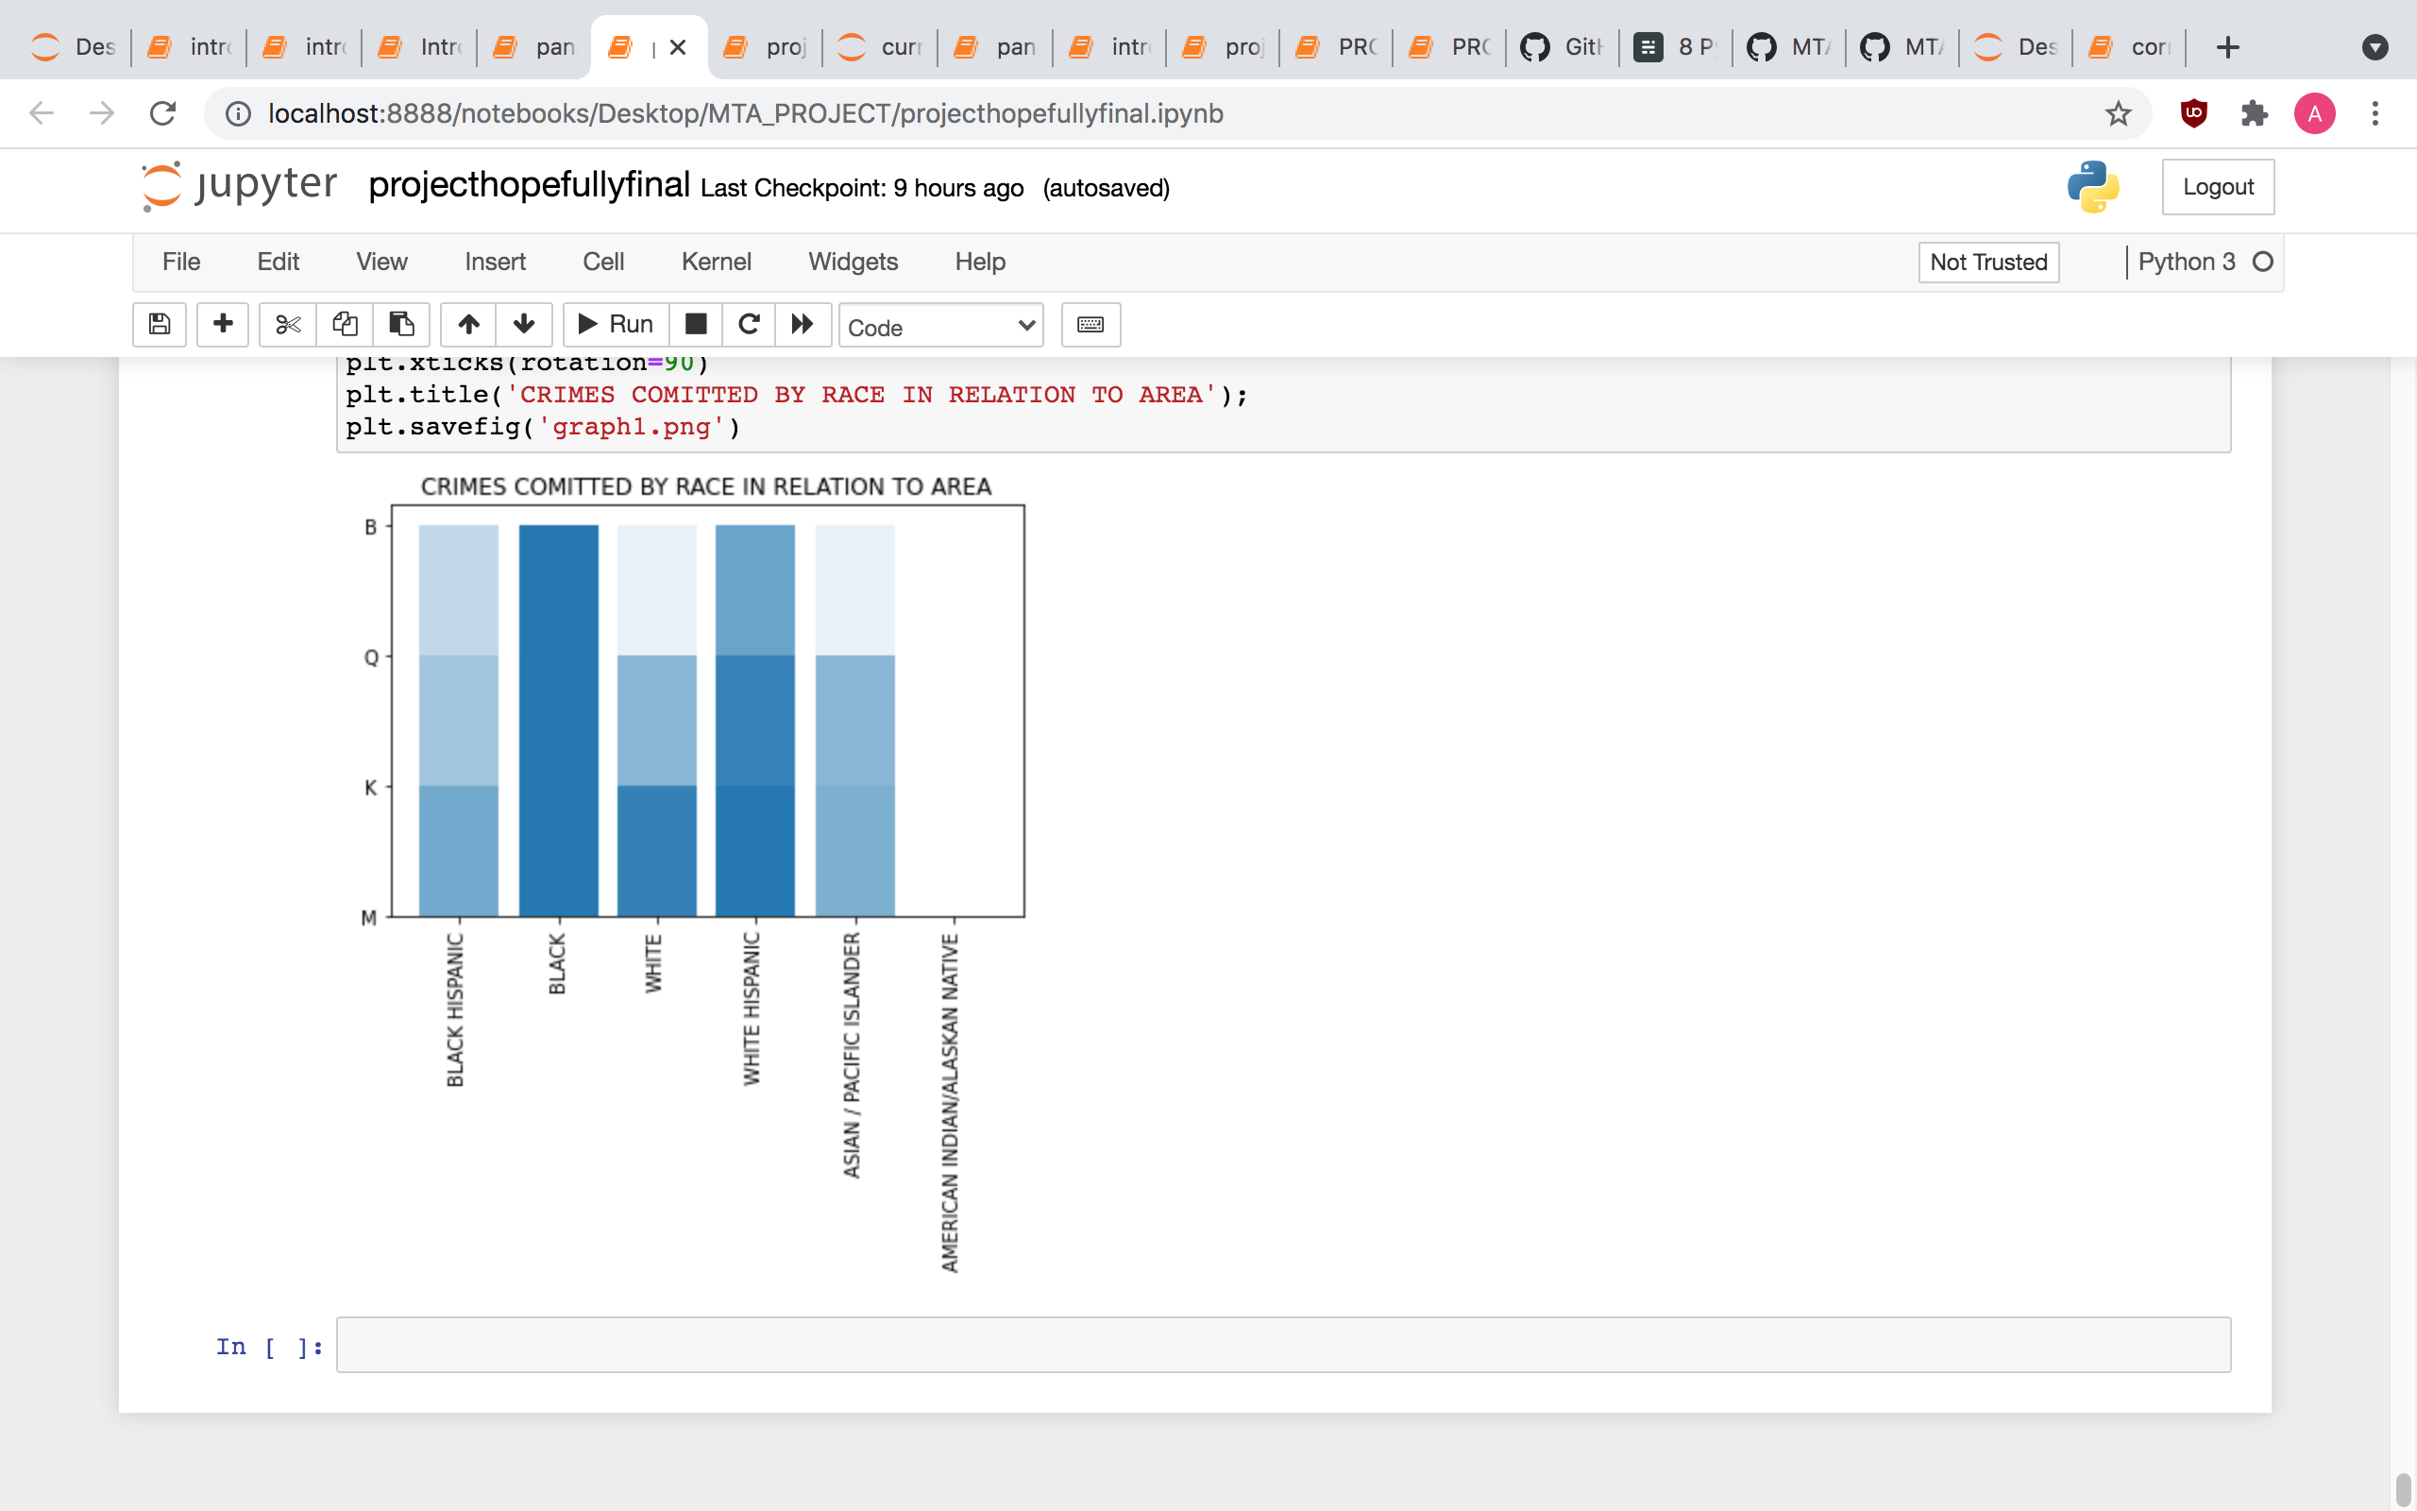
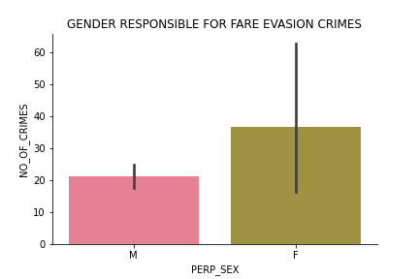

Slide 23

CONCLUSION
There is a correlation between traffic and fare evasion crimes
Holidays are a big cause of fare evasion crimes
Almost everyone commits fare evasion crime
Heavy crime stations will continue to grow

Slide 24

RECOMMENDATIONS
01
01
03
SURVAILING THE ALREADY KNOWN STATIONS FOR CRIME
DISTIRBUTING MANPOWER (PLOICE OFFICERS) DURING THE HOLIDAYS
DISTIRBUTING MANPOWER (PLOICE OFFICERS) DURING THE WEEKENDS
02
02

Slide 25

THANKS!
ANY QUESTIONS?

